Slide 1
The Usefulness of Economic History
We economists are now:
Too good at making theories…
Too good at doing econometrics…
Is a theoretical result an interesting constraint on reality or a demonstration of the ingenuity of the researcher?
Is an econometric-empirical result a robust finding about the world out there or a demonstration that research assistants desperate to please jet-setting tenured bosses can do amazing things?
This is not to say that things were not worse in the old days…
GOOD THEORY IS IN THE END NOTHING BUT DISTILLED AND CRYSTALLIZED ECONOMIC HISTORY!!!!
<https://www.icloud.com/keynote/0zXitPzTmn_VjnTB0str8Jjhg>
<https://www.bradford-delong.com/2019/01/why-economic-history.html>
<https://github.com/braddelong/public-files/blob/master/module-history-usefulness-#IEH-#TCEH-#AEH.pptx>

Slide 2
Why Economic History?
What is our theory—what are the parameters that we are going to estimate?
How are we going to identify our estimation—how do we achieve internal validity?
What have we estimated the wrong model?
Are our properly-identified RCT estimations worth anything—do we have external validity?
What have we missed—for not everything is market exchange and production functions, and even things that are market exchange and production functions have political, sociological, and psychological penumbras around them?

Slide 3
Why Economic History? II
Bob Solow in 1985:
All narrowly economic activity is embedded in a web of social institutions, customs, beliefs, and attitudes. Concrete outcomes are indubitably affected by these background factors, some of which change slowly and gradually, others erratically.... If economists set themselves the task of modeling particular contingent social circumstances, with some sensitivity to context, it seems to me that they would provide exactly the interpretive help an economic historian needs....
[But] the best and brightest in the [economics] profession proceed as if economics is the physics of society. There is a single universally valid model of the world. It only needs to be applied.... Hard sciences dealing with complex systems... like the hydrogen atom or the optic nerve seem to succeed because they can... experiment, and... make repeated observations under controlled conditions. Other sciences, like astronomy, succeed because they can make long series of observations under natural but essentially stationary conditions.... Neither of these roads to success is open to economists…,

Slide 4
Why Economic History? II
The validity of an economic model may depend on the social context. What is here today may be gone tomorrow.... The economist is concerned with making and testing models of the economic world as it now is, or as we think it is. The economic historian can ask whether this or that story rings true when applied in earlier times or other places, and, if not, why not... imagine how things might have been before they became as they now are....
Economic history can offer the economist a sense of the variety and flexibility of social arrangements and thus, in particular, a shot at understanding a little better the interaction of economic behavior and other social institutions...

Slide 5
Why Economic History? III
And:
Unfortunately, however, economics is a social science. It is subject to Damon Runyon's Law that nothing between human beings is more than three to one…. Much of what we observe cannot be treated as the realization of a stationary stochastic process without straining credulity…. My impression is that the best and brightest in the profession proceed as if economics is the physics of society. There is a single universally valid model of the world. It only needs to be applied.
You could drop a modern economist from a time machine- a helicopter, maybe, like the one that drops the money-at any time, in any place, along with his or her personal computer; he or she could set up in business without even bothering to ask what time and which place. In a little while, the up-to-date economist will have maximized a familiar-looking present-value integral, made a few familiar log-linear approximations, and run the obligatory familiar regression. The familiar coefficients will be poorly determined, but about one-twentieth of them will be significant at the 5 percent level…. The other nineteen do not have to be published. With a little judicious selection here and there, it will turn out that the data are just barely consistent with your thesis adviser's hypothesis... everywhere and always, modulo an information asymmetry, any old informa- tion asymmetry, don't worry, you'll think of one.... If the project of turning economics into a hard science could succeed, it would surely be worth doing. No doubt some of us should keep trying...

Slide 6
Why Economic History? IV
The other nineteen do not have to be published.
With a little judicious selection here and there, it will turn out that the data are just barely consistent with your thesis adviser's hypothesis... everywhere and always, modulo an information asymmetry, any old information asymmetry, don't worry, you'll think of one....
If the project of turning economics into a hard science could succeed, it would surely be worth doing. No doubt some of us should keep trying...

Slide 7
Why Economic History? V
We are now:
Too good at making theories…
For every ε>0, there exists a δ such that a theorist can build a model Mδ within δ of complete theoretical rigor so that the conclusions C(Mδ) are within ε of what the economist desires to prove…

Slide 8
Why Economic History? VI
We are now:
Too good at doing econometrics…
Results we do not like can be dismissed as not properly identified…
Results we want to attain can be attained by some sufficiently clever choice of instrument…

Slide 9
Readings: Why Economic History?
Robert M. Solow (1985): Economic History and Economics <http://www.jstor.org/stable/1805620>
Kenneth J. Arrow (1985): Maine and Texas <http://www.jstor.org/stable/1805618>
Paul Krugman (2011): Mr. Keynes and the Moderns <https://voxeu.org/article/mr-keynes-and-moderns>
Carl Shapiro and Hal Varian (1999): Information Rules: A Strategic Guide to the Network Economy, selections <https://delong.typepad.com/files/shapiro-variation-rules-selections.pdf>

Slide 10
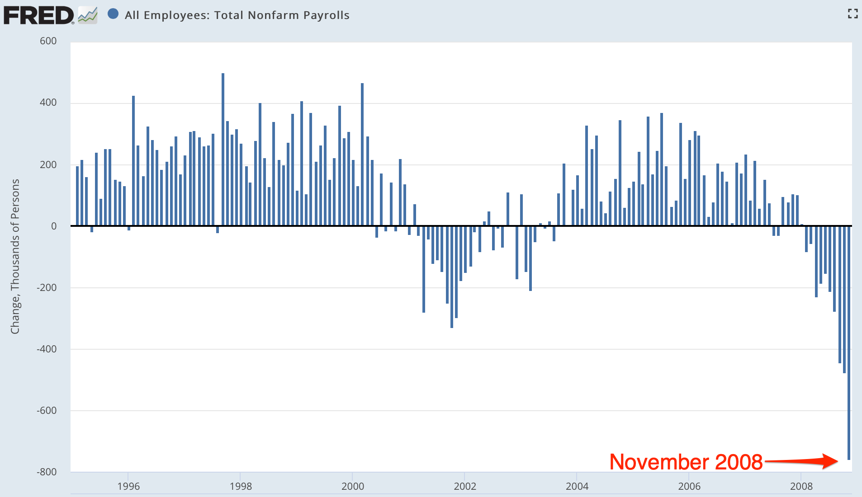
What Are the Insights?
Scene: The Presidential Transition Offices, 8:30 am EST Friday December 5, 2008:
Questions:
Just what is going on?
What is the government supposed to be doing to stop it from doing that?
What can our economists tell us about the best policy response?

Slide 11
Scene: The Bretton Woods Hotel, in Bretton Woods, NH, in April 2011
Martin Wolf: How far do you feel that what we have experienced in the last few years suggests that economists just did not understand what was going on?
Larry Summers: There are things economists did not know. There are things economists were wrong about. And there are things where some economists were right…. When I was in the government, I got a lot of papers…. I attempted to read all of the ones that used the words "leverage," "liquidity," "deflation," or “depression”… I attempted to read none of the ones that used the words "neoclassical," "choice-theoretic," "real business cycle," or "optimizing model of”. There were more in the second…

Slide 12
Summers at the Bretton Woods Hotel II
But there were a reasonable number in the first. And they told you a lot. There is a lot in [Walter] Bagehot['s 1873 Lombard Street] about the crisis we just went through. There is more in [Hyman] Minsky. And there is still more in [Charles] Kindleberger['s 1978 Manias, Panics, and Crashes]….
There are enormous amounts that are essentially distracting, confusing, and problem-denying in the stuff that is the substance of the first year course in Ph.D. programs. I think economics knows a fair amount. I think economics has forgotten a fair amount that is relevant. And it has been distracted by an enormous amount…

Slide 13
Summers at the Bretton Woods Hotel III
People who were practical understood… liquidity finding its way into… asset price inflation and being problematic… but those concepts were at the very edge—or in many cases not even at the very edge—of contemporary macroeconomics, to the great detriment of contemporary macroeconomics.
The wisdom that is in the Bagehot-Minsky-Kindleberger-Eichengreen-Akerlof-Shiller… runs way ahead of those who bring negative attitudes to economics.… We make a serious mistake when we throw the baby out with the bathwater….
But… the vast edifice in both its new Keynesian variety and its new classical variety of attempting to place microfoundations under macroeconomics was not something that informed the policy-making process in any important way…

Slide 14
Insights: Solow
Robert Solow: Complicated system... cannot conduct controlled experiments... a social science... subject to Damon Runyon's Law that nothing between human beings is more than three to one... narrowly economic activity is embedded in a web of social institutions, customs, beliefs, and attitudes….
As soon as time-series get long enough to offer hope of discriminating among complex hypotheses, the likelihood that they remain stationary dwindles away, and the noise level gets correspondingly high. Under these circumstances, a little cleverness and persistence can get you almost any result you want….
If the project of turning economics into a hard science could succeed, it would surely be worth doing. No doubt some of us should keep trying….
The economic historian can ask whether this or that [model-]story rings true when applied in earlier times or other places, and, if not, why not... offer… a sense of the variety and flexibility of social arrangements... the interaction of economic behavior and other social institutions…

Slide 15
Insights: Arrow
Kenneth Arrow: The use of economic history as a source of empirical evidence for testing theories and estimating relations....
A second use… historical conditioning… national or cultural conditioning…. Cultural differences between nations, with all their implications for polity and economy, are precipitates of past events.... It will always be true that practical understanding of the present will require knowledge of the past...

Slide 16
Insights: Krugman
Paul Krugman: There’s no way for me to make this point without citing specific examples, which means naming names. So, on the first point, here’s Chicago’s John Cochrane (2009):
“First, if money is not going to be printed, it has to come from somewhere. If the government borrows a dollar from you, that is a dollar that you do not spend, or that you do not lend to a company to spend on new investment. Every dollar of increased government spending must correspond to one less dollar of private spending. Jobs created by stimulus spending are offset by jobs lost from the decline in private spending. We can build roads instead of factories, but fiscal stimulus can’t help us to build more of both. This is just accounting, and does not need a complex argument about ‘crowding out’…”
Did Cochrane know that he was assuming that the U.S. in 2009 was well-modeled as an economy with a fixed stock of inside money and a rigid cash-in-advance constraint?

Slide 17
Insights: Krugman II
If much of our public debate over fiscal policy has involved reinventing the same fallacies Keynes refuted in 1936, the same can be said of debates over international financial policy. Consider the claim, made by almost everyone, that given its large budget deficits the US desperately needs continuing inflows of capital from China and other emerging markets. Even very good economists fall into this trap.
Just last week Ken Rogoff declared that:
“loans from emerging economies are keeping the debt-challenged US economy on life support.” US economy on life support.”
Um, no: inflows of capital from other nations simply add to the already excessive supply of U.S. savings relative to investment demand.
These inflows of capital have as their counterpart a trade deficit that makes America worse off, not better off.
If the Chinese, in a huff, stopped buying Treasuries they would be doing us a favour.
And the fact that top officials and highly regarded economists don’t get this, 75 years after the General Theory, represents a sad case of intellectual regression…

Slide 18
Insights: Warsh on Shapiro and Varian’s Information Rules
David Warsh: As they increasingly were drawn into the policy battles of the information age, Shapiro and Varian heard the constant refrain… the old rules had been broken; a new set of principles was required to guide business strategy and public policy…. But, they said, ou don't need a brand-new economics. You just need to see the really cool stuff. Incompatible standards… Edison and Westinghouse in electricity…. Neither positive feedback and network externalities… is… recent…. Railroads, highways, electricity grids, television, e-mail: all obey the same basic principles…

Slide 19
Catch Our Breath…
Ask a couple of questions?
Make a couple of comments?
Any more readings to recommend?

